Slide 1

Basic Electrical Engineering (BEEE101L)
Presented By
Dr. Maddela Chinna Obaiah
Assistant Professor (Sr)
School of Electrical Engineering

Slide 2
Module – 2: AC circuits
Alternating voltages and currents, AC values,
Single Phase RL, RC, RLC Series circuits,
Power in AC circuits –Power Factor
Three Phase Systems – Star and Delta Connection

Slide 4
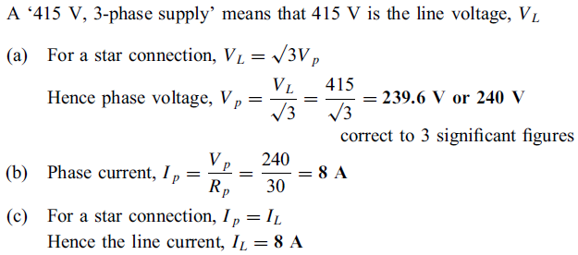
Problem: Three loads, each of resistance 30 , are connected in star to a 415 V, 3-phase supply. Determine (a) the system phase voltage, (b) the phase current and (c) the line current.
Solution:

Slide 5
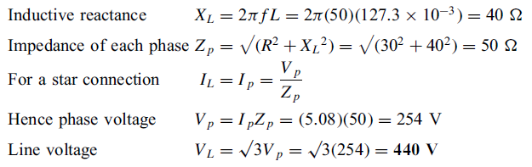
Problem: A star-connected load consists of three identical coils each of resistance 30 and inductance 127.3 mH. If the line current is 5.08 A, calculate the line voltage if the supply frequency is 50 Hz
Solution:

Slide 6
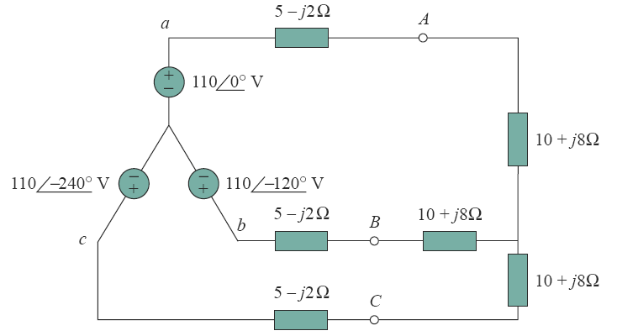
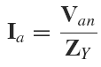
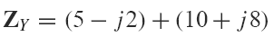
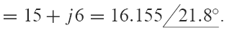
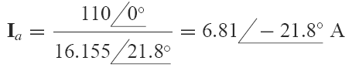
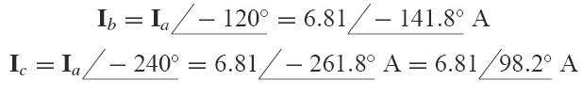
Problem: Calculate the line currents in the three-wire Y-Y system of Fig.
Solution:
where

Slide 9
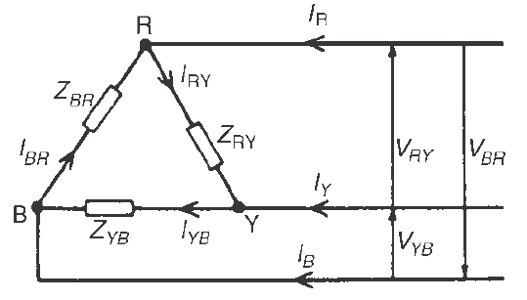
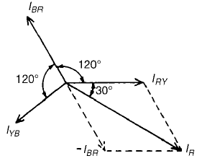
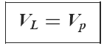
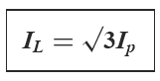
Delta connection
It can be seen that the line voltages V_{RY},V_{YB} and V_{BR} are the respective phase voltages, i.e. for a delta connection:
I_{R} = I_{RY} - I_{BR} = I_{RY} + (- I_{BR})

Slide 10
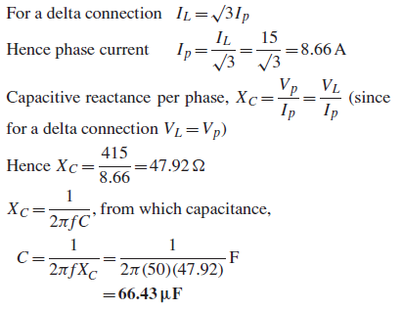
Problem: Three identical capacitors are connected in delta to a 415V, 50Hz, 3-phase supply. If the line current is 15 A, determine the capacitance of each of the capacitors.
Solution:

Slide 11
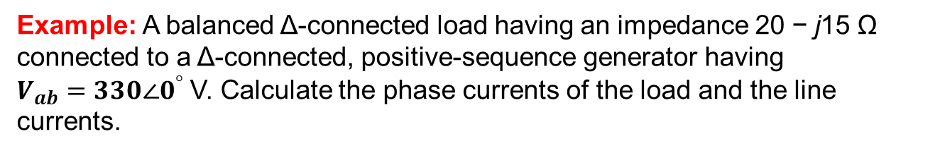
Example: A balanced Δ-connected load having an impedance 20 − j15 Ω connected to a Δ-connected, positive-sequence generator having
$V_{ab}=330∠0^{°}$ V. Calculate the phase currents of the load and the line
currents.

